Slide 1
Metagonimus yokogawii:
in fish eating mammals in Asia; utilizes freshwater trout, other salmonids, and cyprinids, for second intermediate hosts. The adult which measured 1-2.5 X 0.4-0.7 millimeter, the whole body is covered with spiny cuticle, ventral sucker at right side of the body. Egg with operculum and miracidum inside egg shell measured 27-30 X 15-17 µm, the figure of this parasite collected from dog's intestine from Basrah city/ southern Iraq in 2004 by Prof. Dr. Suzan Al-Azizz as a first record in Iraq and Basrah city.

Slide 3
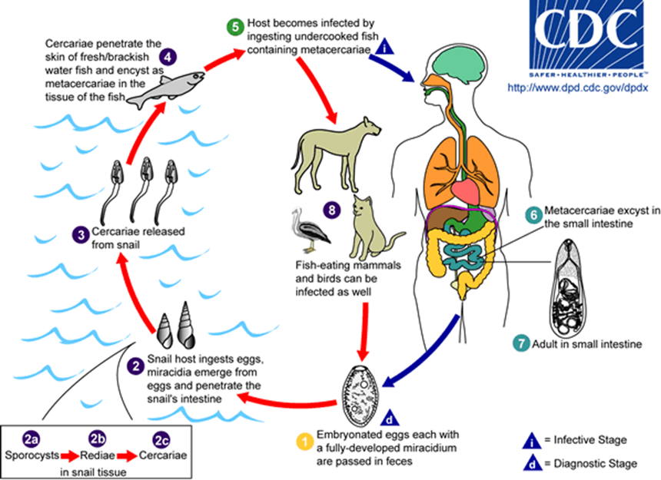

Slide 4
Lung Flukes
1- Family: Troglotrematidae:
Paragonimus westermani
The human lung fluke, it is found in the Orient including India and Philippines. Nearly 50 known species in the genus; this particular species is found in North America. Large, fleshy worms that live in the lungs. Found in canines, pigs, felids, raccoons, goats, muskrats, opossum, and even two reports from humans also.
Definitive host becomes infected by eating improperly cooked crustacean. Adult infections become established in lungs but larval forms may wander into brain, pleura, mesentery, etc. (ectopic infection).

Slide 5
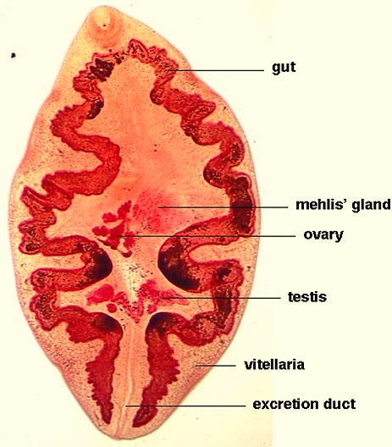
Reservoir hosts include - dogs, cats, pigs, rodents, and other animals .

Slide 6
Pathology
• Early invasive stages usually asymptomatic.
• In the lung or ectopic site, connective tissue forms pseudo tubertules. In the CNS, they can cause paralysis and in rare cases can be fatal. In the heart they can cause severe damage and can be fatal.
• infections cause chronic cough, bloody sputum, pneumonia -like conditions.
Prevention includes
– Cooking of crabs, crayfish
– Care when eating salads, no crab juice.
– Proper disposal of feces and sputum.

Slide 7
Life-cycle
Adults encysted as pairs in lungs, eggs up trachea; out with feces, then, mature in environment in several weeks after that hatch to miricidium which penetrates special intermediate host snail (Pomatiopsislapidaria), then, sporocyst and two redial generations, later, cercariae either emerge and penetrate crayfish (i.e. Cambarus spp.) , or snail with cercariae eaten by crayfish. Other Paragonimus spp. may use freshwater crabs or other crayfish species. The metacercaria in gills, muscle eaten by definitive host which bores through gut wall; through diaphragm and penetrates lung directly maturation into adults.

Slide 8
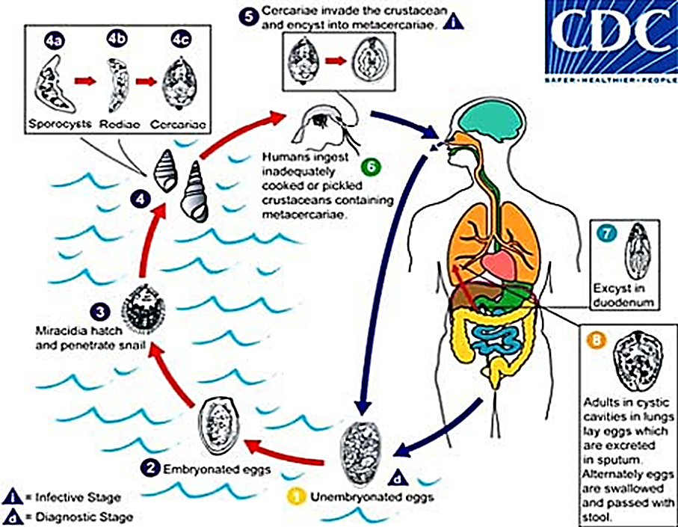

Slide 9
THANK YOU

